Slide 1

Predicting the severity of car accident
Abiola Adeyinka

Slide 2
Predicting severity of car accident
Accidents are major concerns for most countries.
Approximately, 1.25 million people die from road accidents in a year (WHO)
Objective: predict how severity of accidents can be reduced based on few factors.
Generally, prediction in severity of accidents can help car drivers in taking precautions to reduce the severity of accidents.
It can also be beneficial to the government in working towards improving infrastructures to will minimize car accidents.

Slide 3
Data Acquisition
Accident severity data (2004 – present) from Seattle Police Department and recorded by Traffic records groups.
The dataset consists of 194,673 rows and 37 columns.
The target variable is SEVERITYCODE with class of 1 and 2.
Categorical data were converted to numerical data, missing data, highly correlated features were dropped..

Slide 4
Data Preprocessing
Categorical data were converted to numerical data.
missing data are dropped
highly correlated features were dropped..
The target variable was label encoded

Slide 5
Feature selection
Feature | Description
ROADCOND | Road condition during collision (wet, dry)
LIGHTCOND | Light condition during collision (light on, dark …)
WEATHER | Weather condition during collision (clear, rain, overcast …)

Slide 6
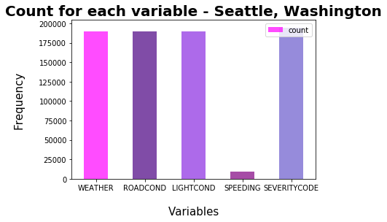
Data Visualization

Slide 7
Handling Imbalanced sample
Under sampling using sklearn resample library
The severity code classes were highly imbalanced with a 2:1 ratio.
Most of the algorithms are biased towards most frequent classes. However, efficient pre-processing and corresponding imbalanced data technique should give optimal results

Slide 8
Algorithms used
Decision Tree Classifier with max depth = 7
K-Nearest Neighbor Classifier with k = 21
Logistic regression classifier with C = 6

Slide 9
Model Evaluation
Algorithm | Jaccard | F1-score | Log Loss
K-Nearest Neighbor | 0.564 | 0.540 | NA
Decision Tree | 0.566 | 0.545 | NA
Logistic Regression | 0.526 | 0.511 | 0.684

Slide 10
Conclusions
Useful models were built to predict the severity based on few factors
The models can be improved upon by performing more pre-processing method to the data.
Based on the above report, Decision tree is the best model to predict car accident severity.
Based on the dataset, weather, road, and light conditions pointing to certain classes, have a somewhat impact on whether or not travel could result in property damage (class 1) or injury (class 2).

Slide 11
Recommendations
The car drivers could use the data to assess when to take extra precautions on the road under the given circumstances of light condition, weather condition, road condition in order to avoid severe accident.
Also, the government could use the data to launch development projects in areas were accidents have been recurring due to the road and lighting conditions by trying to minimize the effects.

Slide 12
References
https://www.who.int/news-room/fact-sheets/detail/road-traffic-injuries
https://wsdot.wa.gov/

